Slide 1

Boosting Algorithms

Slide 2
Contents
Adaptive Boosting aka Adaboost
Gradient Boosting
Extreme Gradient Boosting aka XGBoost

Slide 3
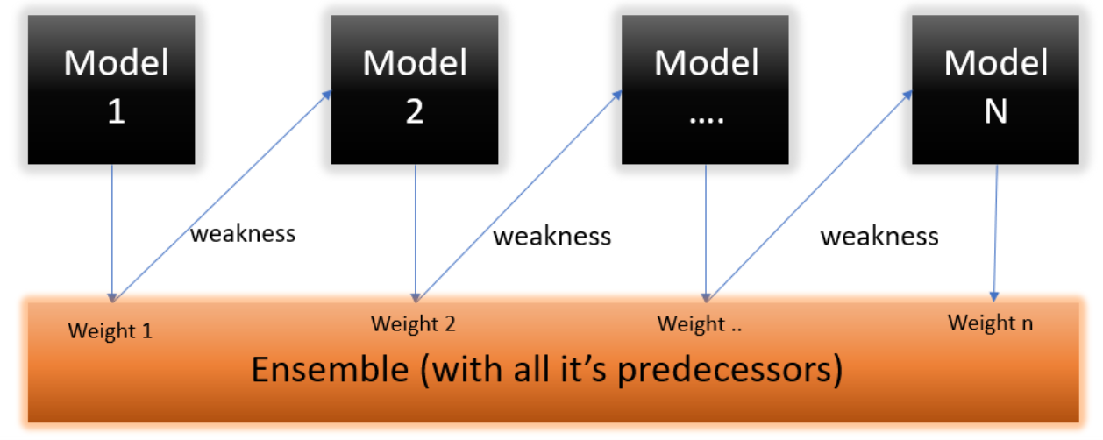
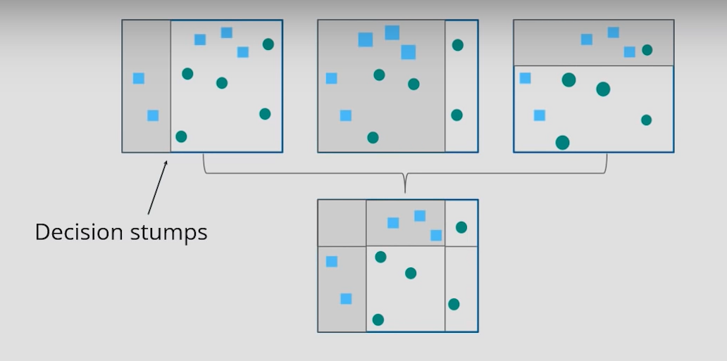
Adaptive Boosting aka Adaboost
1. Assign equal weights to all data points and build a model. Just simply build the model on the data set.
2. Identify the points which are wrongly classified and assign them a higher weightage.
3. Build a new model with those wrongly classified data points having higher weightage.
4. The new model does better classification and gives lower error
5. Repeat steps 2 to 4 till the error is low enough

Slide 4
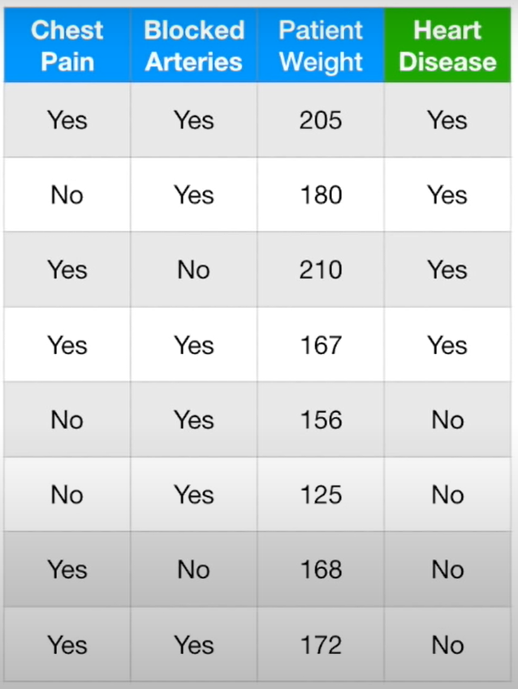
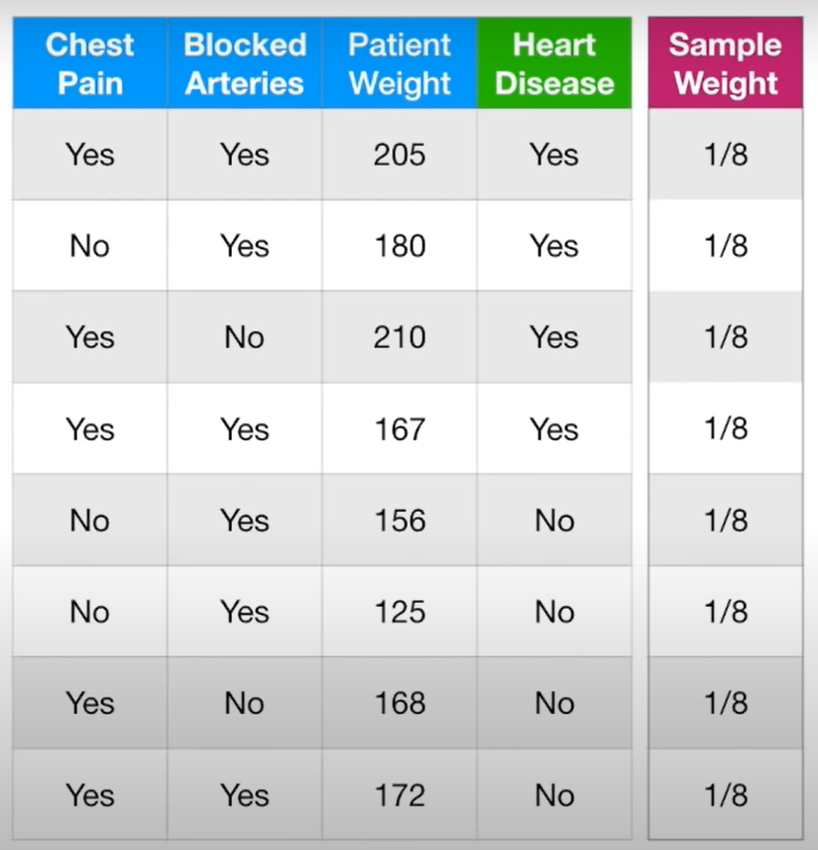

Slide 5
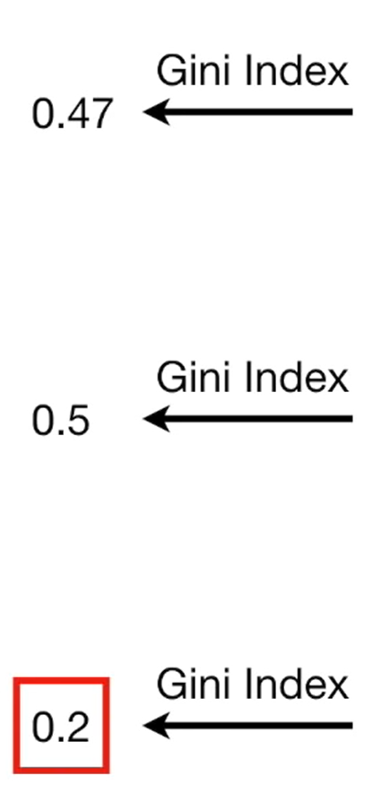
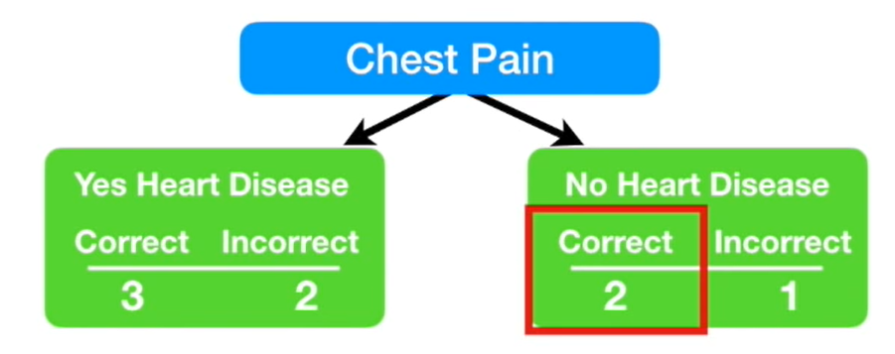
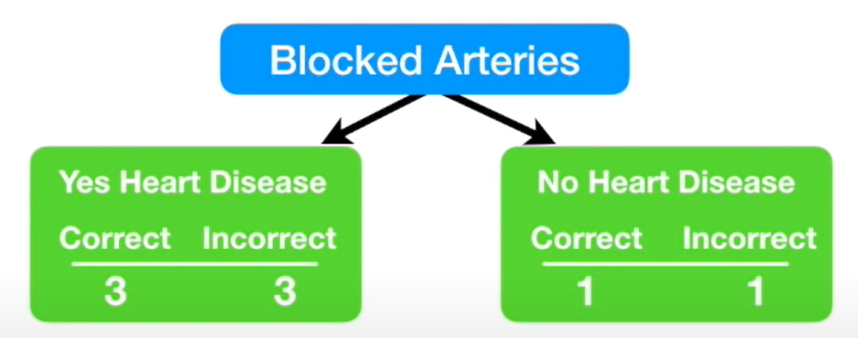
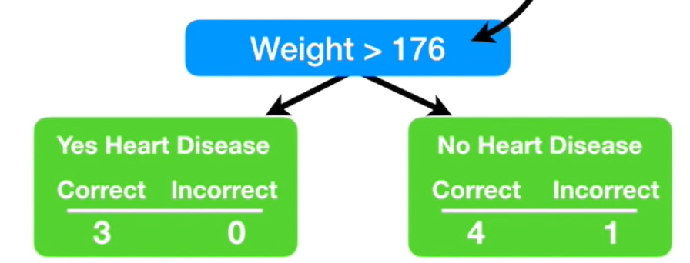

Slide 6
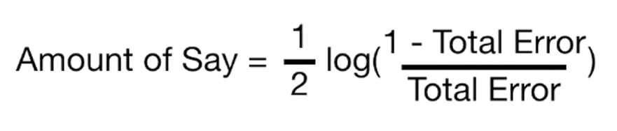
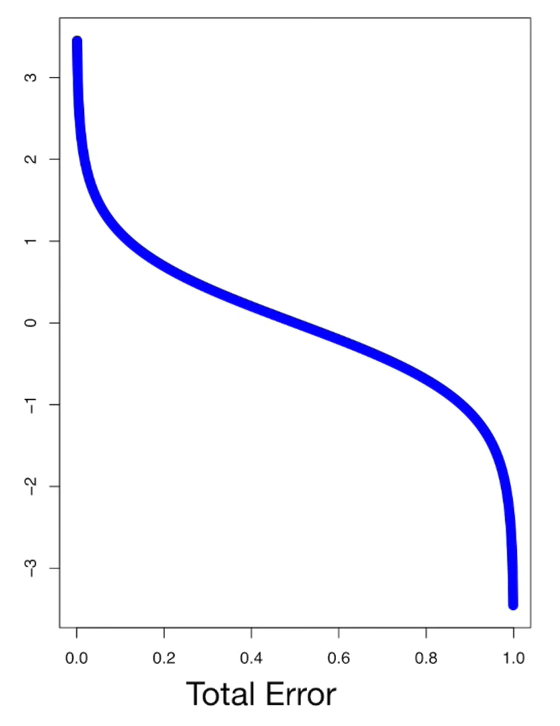

Slide 7
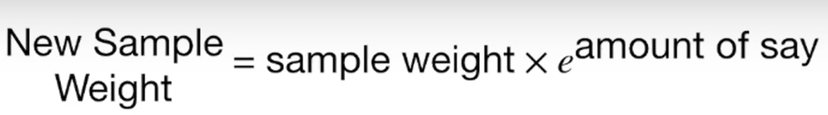

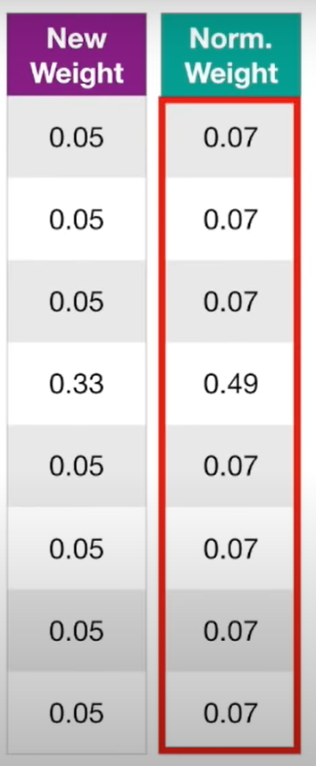
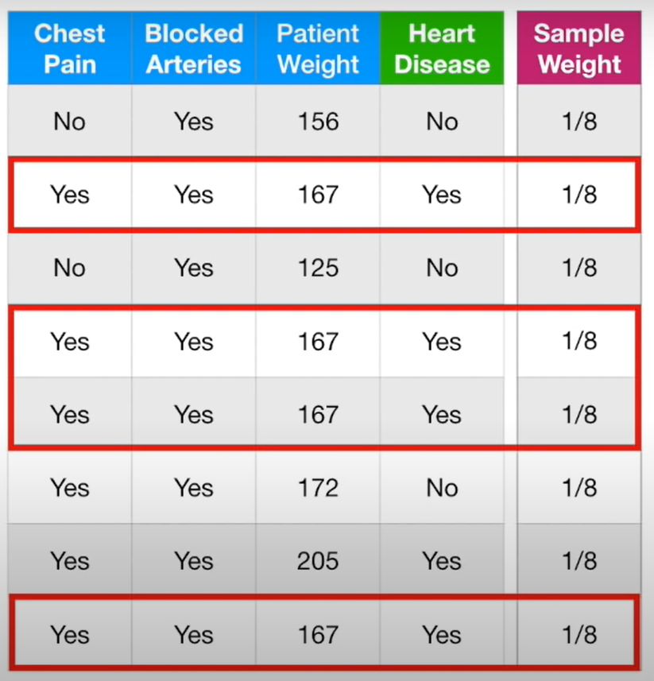

Slide 8
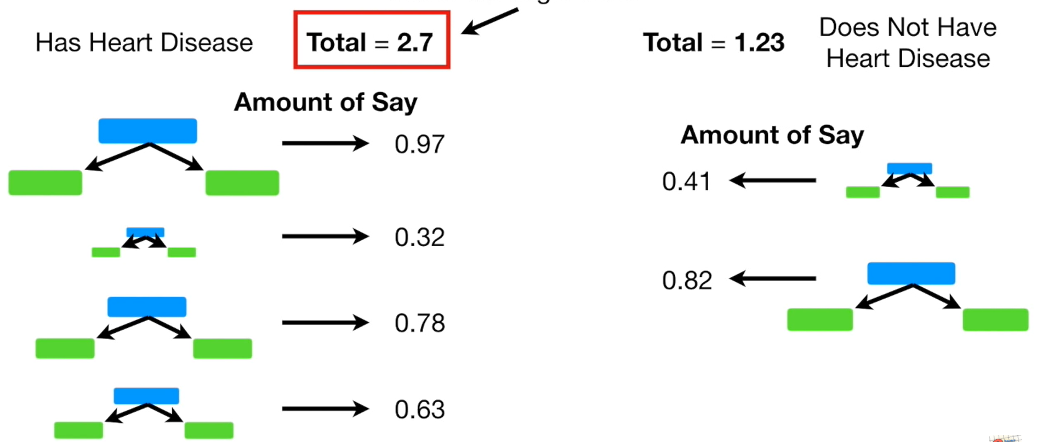

Slide 9
Adaboost Review
Adaboost combines a lot of weak learners to make classifications. The weak learners are generally stumps
Some Stumps classify better than the others and are more important
Each new Stump is made by taking the previous stump’s mistakes/errors into account.

Slide 10
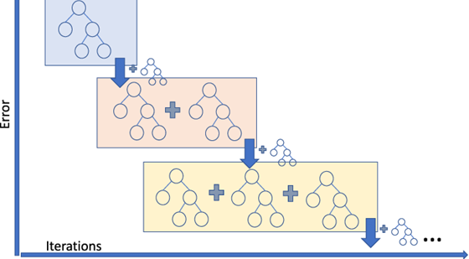
2. Gradient Boosting
How Gradient Boosting Works
Gradient boosting involves three elements:
A loss function to be optimized.
A weak learner to make predictions.
An additive model to add weak learners to minimize the loss function.

Slide 11
1. Loss Function
The loss function used depends on the type of problem being solved.
It must be differentiable, but many standard loss functions are supported and you can define your own.
For example, regression may use a squared error and classification may use logarithmic loss.

Slide 12
2. Weak Learner
Short Decision trees with 4 to 8 levels or stumps are used as the weak learner in gradient boosting.
Trees are constructed in a greedy manner, choosing the best split points based on purity scores like Gini or to minimize the loss.
It is common to constrain the weak learners in specific ways, such as a maximum number of layers, nodes, splits or leaf nodes.
This is to ensure that the learners remain weak, but can still be constructed in a greedy manner.

Slide 13
3. Additive Model
Trees are added one at a time using gradient descent procedure to minimize the loss, and existing trees in the model are not changed.
To perform the gradient descent procedure, we must add a tree to the model that reduces the loss. We do this by parameterizing the tree, then modify the parameters of the tree and move in the right direction.
The output for the new tree is then added to the output of the existing sequence of trees in an effort to correct or improve the final output of the model.
A fixed number of trees are added or training stops once loss reaches an acceptable level or no longer improves on an external validation dataset.

Slide 14
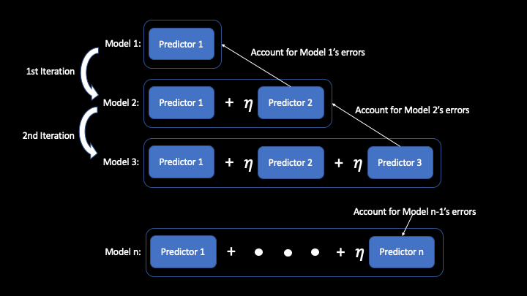
3. Extreme Gradient Boosting aka XGBoost
XGBoost is an algorithm that has recently been dominating applied machine learning and Kaggle competitions for structured or tabular data.
XGBoost is an implementation of gradient boosted decision trees designed for speed and performance.

Slide 15
Algorithm Features
The implementation of the algorithm was engineered for efficiency of compute time and memory resources. A design goal was to make the best use of available resources to train the model. Some key algorithm implementation features include:
Sparse Aware implementation with automatic handling of missing data values.
Block Structure to support the parallelization of tree construction.
Continued Training so that you can further boost an already fitted model on new data

Slide 16
What Algorithm Does XGBoost Use?
The XGBoost library implements the gradient boosting decision tree algorithm.
This algorithm goes by lots of different names such as gradient boosting, multiple additive regression trees, stochastic gradient boosting or gradient boosting machines.
It uses a gradient descent algorithm to minimize the loss when adding new models.
This approach supports both regression and classification predictive modeling problems.

Slide 17
References
StatQuest with Josh Starmer - AdaBoost, Clearly Explained – YouTube
A Gentle Introduction to the Gradient Boosting Algorithm for Machine Learning (machinelearningmastery.com)
Extreme Gradient Boosting (XGBoost) Ensemble in Python (machinelearningmastery.com)
Boosting Machine Learning Tutorial | Adaptive Boosting, Gradient Boosting, XGBoost | Edureka - YouTube

